Slide 1

Major Project Synopsis Presentation
CYBERPUNK
Student Names:
Akshat Srivastava(1905080100011)
Abhishek Shukla(1905080100001)
Poorvi Mishra(1905080100063)
Class & Section: CS-41
Guide Name:
Mrs. Alka Singh (Assistant Professor) CSE Department,BBDEC

Slide 2
Introduction
❏ An online game portal which provides high graphic cognitive games on internet using browsers. These browser games
run using standard web technologies or browser plug-ins. such games usually involve use of standard web technologies
as a frontend and other technologies as a backend..
❏ Standard web technologies such as HTML, CSS, Django and JavaScript can be used to make browser games, but these
have had limited success because of issue with browser compatibility and quality. .
❏ These technologies collectively termed dynamic HTML, allow for games that can be run in all standard- compliant
browser.

Slide 3
Objective
To develop the user interface of the game.
To integrate user interaction in it.
To develop and manage the back end of the game.
To integrate game with social networking websites.
The aim is how many users are driven with the assistance of the cyberpunk notifications.
Various strategy games are available on internet, among them, one is business strategy game, so we chose to develop an Indian theme-based business strategy game commonly known as monopoly.

Slide 4
Literature Review
We started the project by referring to various online games and research papers on interaction design and game development. The results of the study is discussed as below.
Computer and Video Game History
Earliest online gaming started around 1969, but started to become popular around late 1970s and 1980s when dial up bulletin boards became popular which was used by players to play online games. Commercial online service was introduced in 1980s and interactive online games were introduced after that.
In the 1990s, with the introduction of Java and Flash technology, several online games were introduced based on these technologies. This gave a great boom to the online games.
A brief timeline of online games
Apart from the entertainment purpose that games are intended to provide. There are other benefits also which such games serve. Few such benefits are described below.
Realistic gaming experience
In many online games, user plays against humans, rather than a computer, which provides more realistic gaming experience.
Educational benefits
Several online games are there which focus on education. Playing this game provides pleasure as well as user learns in a fun way.
e.g., Mathematical games, Physics games, Online quizzes.
Relaxation
Games are a great source of entertainment. People when stressed usually play their favorite games in order to escape from stress and to keep them relaxed.

Slide 5
FEATURES OF GOOD ONLINE GAME
There is a large variation present in online games. Few examples can be shooting games, mathematical games, action games, puzzle games, strategy games, etc. But most of these games are developed by foreign countries’ developers. So there is a lack of Indian theme based games in online game sector which lead us to take this project of developing an Indian theme game. Games to which users can relate, are more attractive and people like to play such games often. This project aims to fulfill such gap by developing an Indian theme based online game.
A good online game in one which engages users for a long time without boredom. According to a web article, following are the features of a good online game:
A compelling and original concept
Player support and community
Great graphics and environmental diversity
Good customer service
Fun gameplay
Add-on and mod support
Content additions and refinements
Ease of player interaction
Accessibility

Slide 6
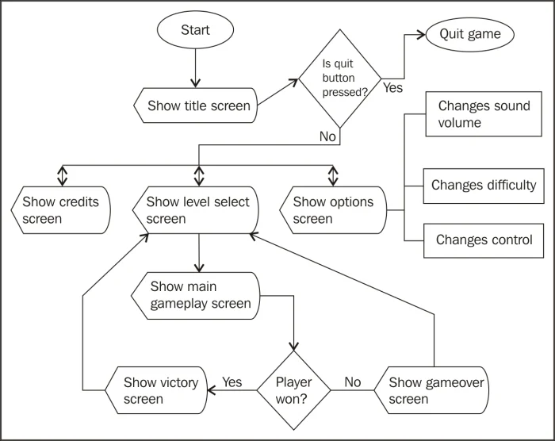
Application Flow Diagram
USER
INQUIRE
DATABASE
Fig 1: Data Flow Diagram (Level 0)

Slide 7

Signup page : 1

Slide 8
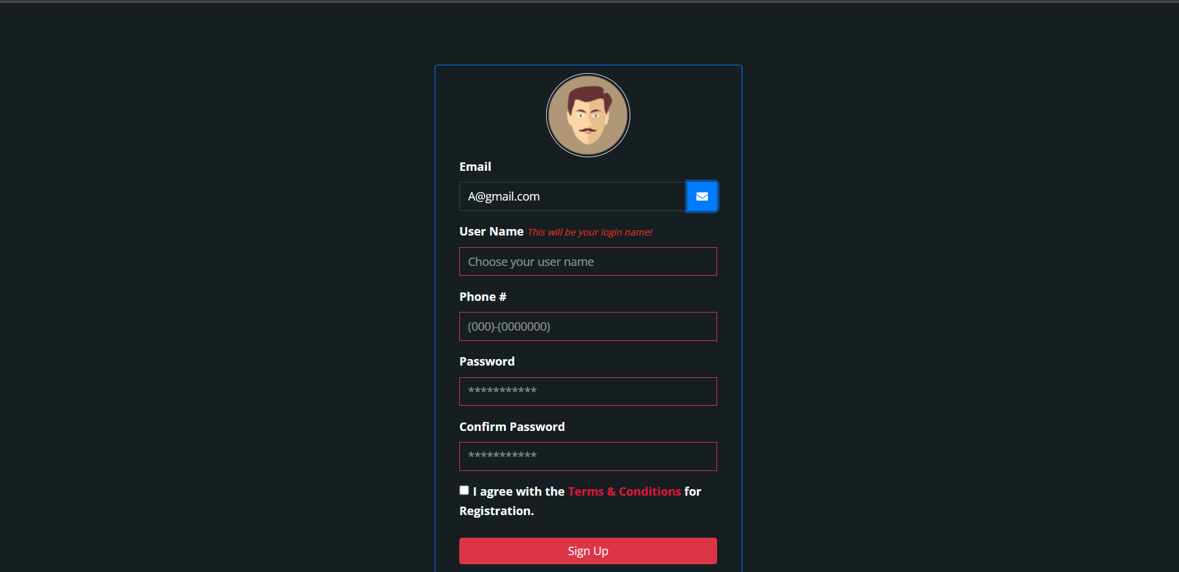
signup page : 2

Slide 9
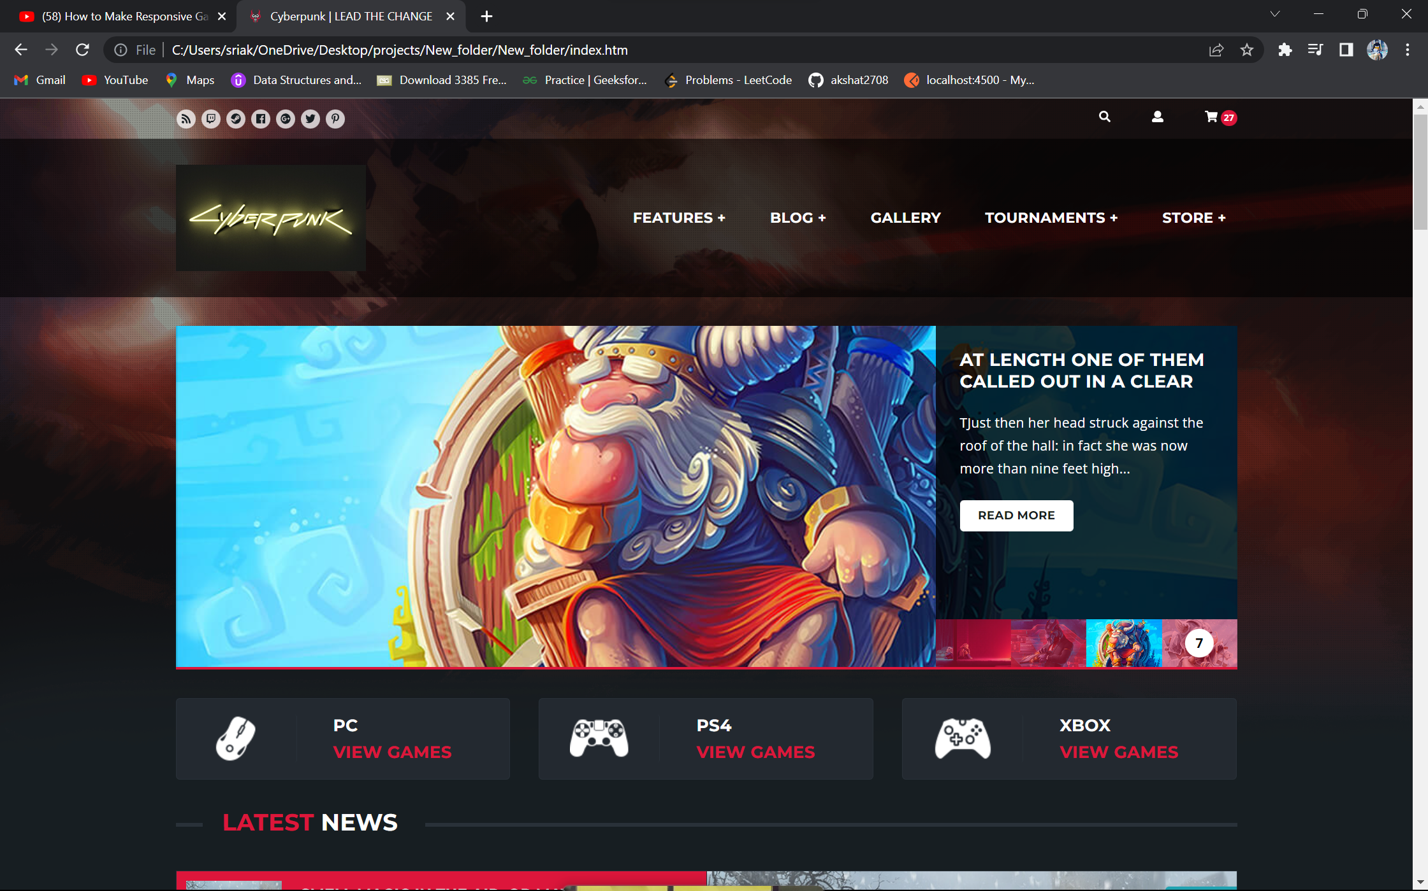

Slide 10
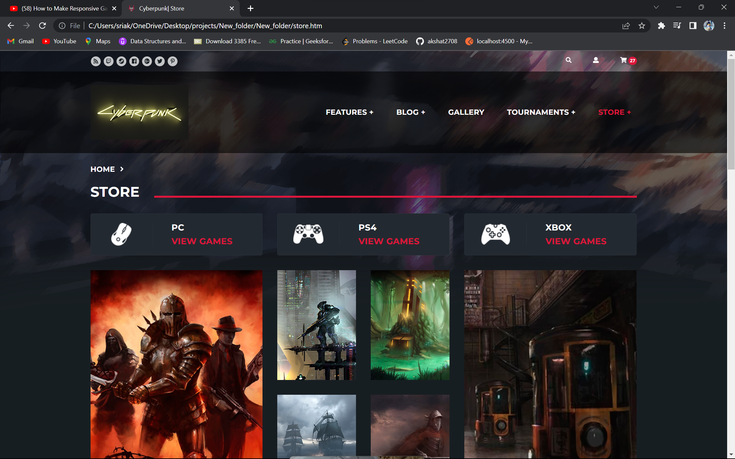

Slide 11
Software /Hardware Requirements
Software Requirements
HTML
CSS
Vs code(Text Editor)
Java Script
Django
Bootstrap
MySQL

Slide 12
Hardware Requirements
Operating System :-Windows 7 and above.
RAM 8Gb
Runs on 64 bit & 6 Core

Slide 13
References
Wikipedia. Browser game. Available from: http://en.wikipedia.org/wiki/Browser_game.
Accessed on: 5/1/2014
Gamespot Staff. QOTW: What Makes an Online Game Successful?[Online]. Accessed on: 20/1/2014 Available from: http://www3.imperial.ac.uk/library/subjectsandsupport/referencemanagement/vancouver/references
Christine Reilly, Nathan Smith Internet Gambling: An Emerging Field of Research. [Online]. Accessed on: 20/2/2014.Available from: http://www.ncrg.org/sites/default/files/uploads/docs/white_papers/ncrg_wp_internetgambling_final. pdf
Nielsen, J. (n.d.). How to Conduct a Heuristic Evaluation. [Online]. Accessed on: 25/3/3014 Available from : http://www.useit.com/papers/heuristic/heuristic_evaluation.html

Slide 14


